Slide 1
Text-Generation Effect
from given Text Prompt using DistilGPT2 Model in NLP
Presented By-
Farzana Rahman-1712173642

Slide 2
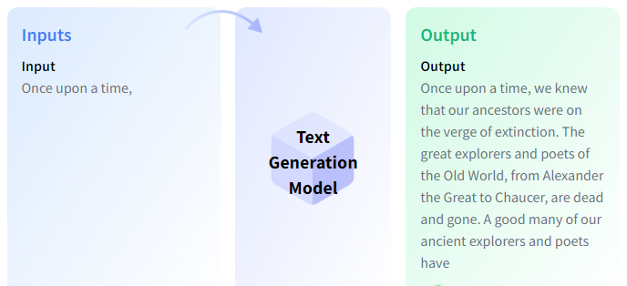
1. What is the problem?
The problem is to find out through generating text and finally producing new text. We used models which can, for example, fill in incomplete text or paraphrase.

Slide 3
2. What models did you use to solve it?
I used Distilled-GPT2 on a pre-trained model “bert-base-cased” to solve it.

Slide 4
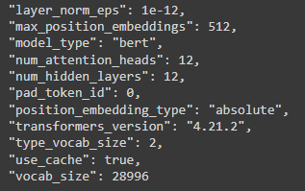
3. The training parameters: batch size, learning rate, epochs, and other optimization parameters.
Examples = 1000
Epochs = 3
Instantaneous batch size per device = 8
Total train batch size (w. parallel, distributed &
accumulation) = 8
Gradient Accumulation steps = 1
Total optimization steps = 375

Slide 5
4. The learning curve (training/validation accuracy), and time required for epochs.
Example 1-A simple example-
results = accuracy_metric.compute(references=[0, 1, 2, 0, 1, 2], predictions=[0, 1, 1, 2, 1, 0])
{'accuracy': 0.5}
Example 2-The same as Example 1, except with `normalize` set to `False`-
results = accuracy_metric.compute(references=[0, 1, 2, 0, 1, 2], predictions=[0, 1, 1, 2, 1, 0], normalize=False)
{'accuracy': 3.0}
Example 3-The same as Example 1, except with `sample_weight` set-
results = accuracy_metric.compute(references=[0, 1, 2, 0, 1, 2], predictions=[0, 1, 1, 2, 1, 0],
sample_weight=[0.5, 2, 0.7, 0.5, 9, 0.4])
{'accuracy': 0.8778625954198473}

Slide 6
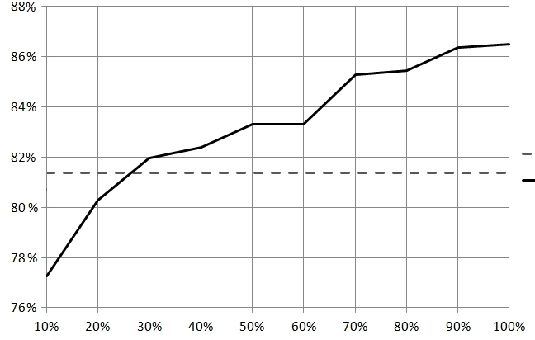
Learning Curve between text prompt vs text generalized.

Slide 7
5. What did you find interesting?
It can also classify and generate emotions(wav2vec2) from audio or video clip.

